Slide 1

GRAPH THEORY and Its APPLICATIONS
Dr. Arti Arya
Department of Computer Science & Engineering

Slide 2

GRAPH THEORY And Its APPLICATIONS
CUT SETS
Dr. Arti Arya
Department of Computer Science & Engineering

Slide 3
Graph Theory and its Applications Disclaimer
The slides are prepared by Dr. Surabhi Narayan and a lot of inputs are added by Dr. Arti Arya. The sources of the information other than text book is mentioned wherever used.

Slide 4
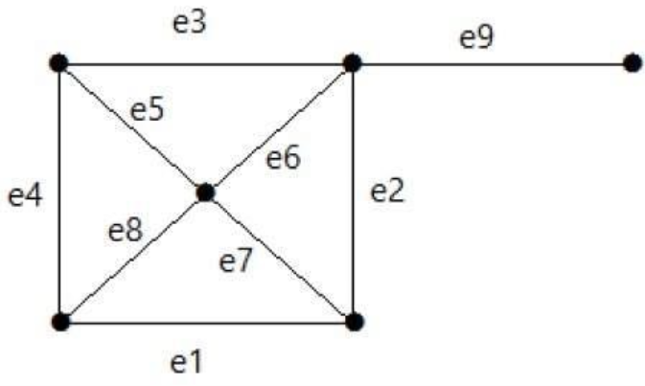
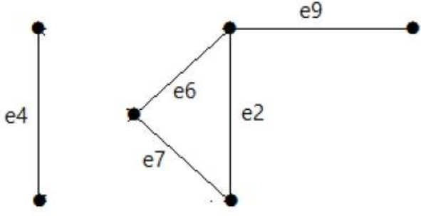
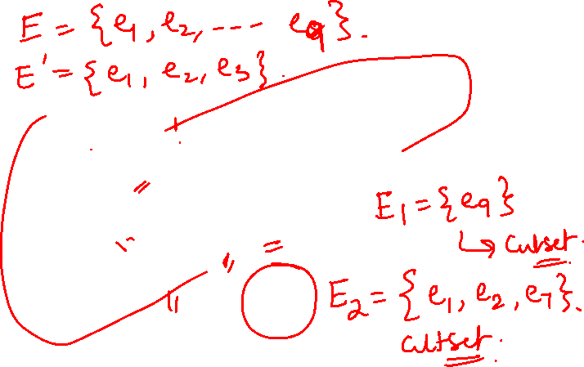
Graph Theory And its Applications Cut Sets
Let G(V,E) be a connected graph. A subset E’ of edges of E is stb a disconnecting edge set in G, if the removal of E’ from E disconnects G.
A set E’ of edges of G is said to be a cut-set in G if the following two conditions hold:
E’ is a disconnecting edge set in E of G
No proper subset of E’ is a disconnecting edge set in G
Its cut set is E1 = {e1, e3, e5, e8}.
E3 = {e9} Smallest cut set of the graph.
E4 = {e3, e4, e5}

Slide 5
Graph Theory And its Applications Cut Sets
Note: When an edge is removed from the graph, the end vertices of the edge continue to remain in the graph.

Slide 6
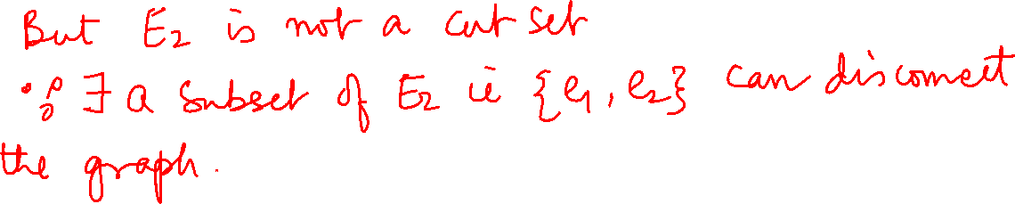

Slide 7
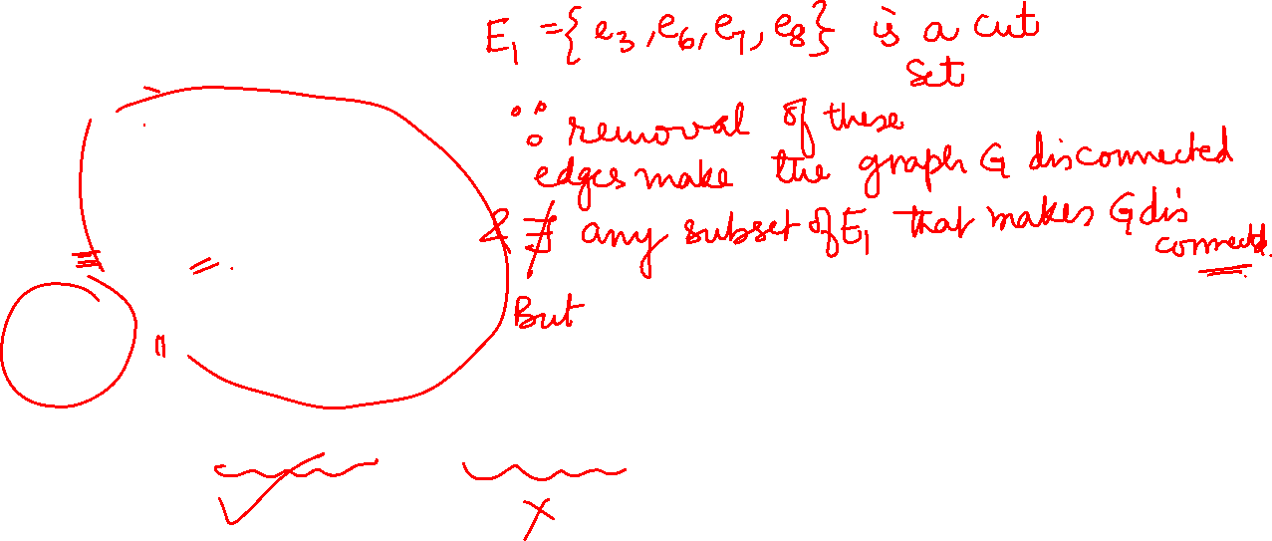
Graph Theory, Applications and Combinatorics Cut Sets
Consider the graph G(V, E)
e3
A
B
e6
e1
e7
e4
e5
A
B
E
D
C
e2
e8
e1
e4
e5
Consider E1 = {e3, e6, e7, e8} and E2 = {e1, e2, e5}.
E
D
C
e2

Slide 8
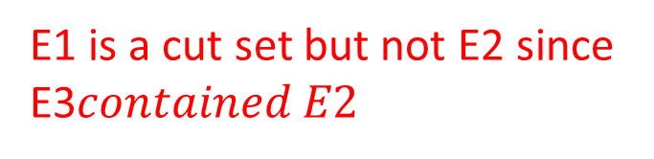
Graph Theory, Applications and Combinatorics Cut Sets
e3
A
B
Let E1 = {e3, e6, e7, e8} and E2 = {e1, e2, e5}
e6
e1
e7
e4
e5
E
D
C
e3
e2
e8
A
B
e6
e3
e7
e4
A
B
e6
e7
e4
e5
E
D
C
e8
E
D
C
E1 is a cut set but not E2 since E3$contained E2$
e8
E3 = {e1, e2}

Slide 9
Graph Theory and its Applications Cut Sets
Is S = {e3, e6, e7, e4} a cut set?
e1
A
B
e2
e7
e6
C
e5
e3
E
D
e4

Slide 10
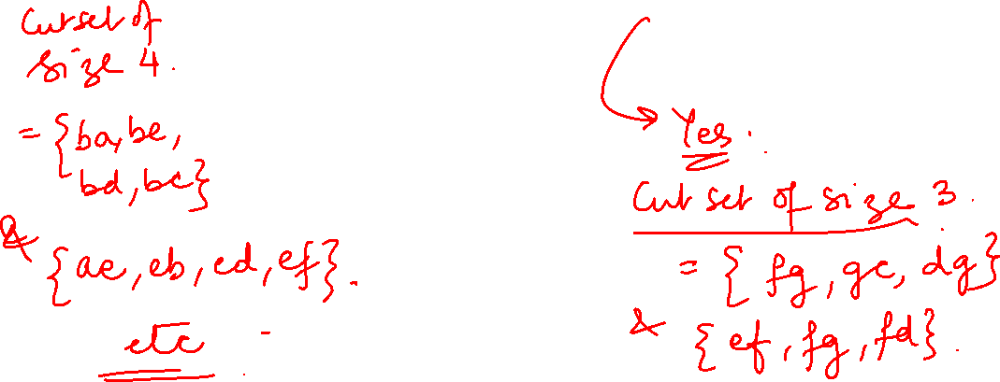
Graph Theory, Applications and Combinatorics Cut Sets
a
b
Is S = {ae, be, bd, bc} a cut set Identify cut sets of size 3 Identify cut sets of size 4
d
c
e
f
g

Slide 11
Graph Theory and its Applications Cut Sets
Bridge: A Cut set consisting of a single edge is called a bridge
a
b
d
c
e
g

Slide 12
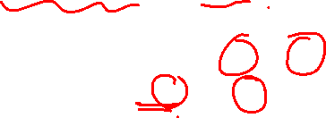
Graph Theory, Applications and Combinatorics Cut Sets
Cut Set with respect to a pair of vertices:
Let G be a connected graph and A and B be a pair of vertices of G. Then a cutset in G whose removal places A and B into two different parts of G is called a cutset with respect to A and B
Capacity of a cutset: Let E’ be the cutset of G. Then the sum of weights of all edges in E’ is called the capacity of E’.
Capacity of cutset {e1, e4, e7} = wt(e1) + wt(e4) + wt(e7)

Slide 13
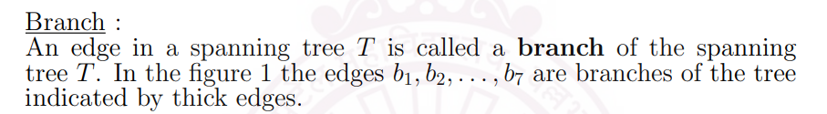
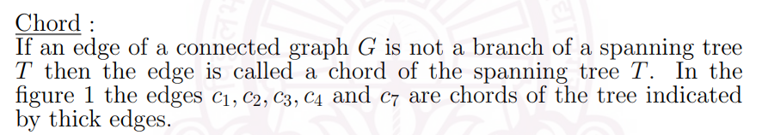
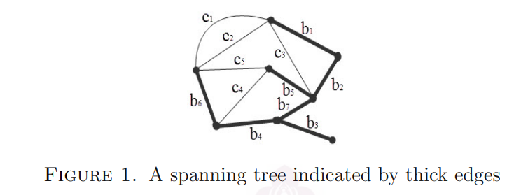
Graph Theory and its Applications Few Terminologies

Slide 14
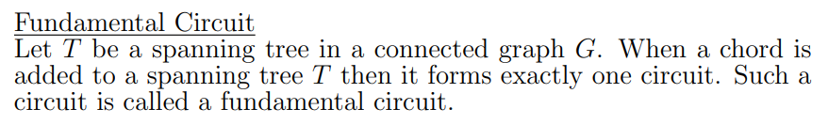
Graph Theory and its Applications Few Terminologies

Slide 15
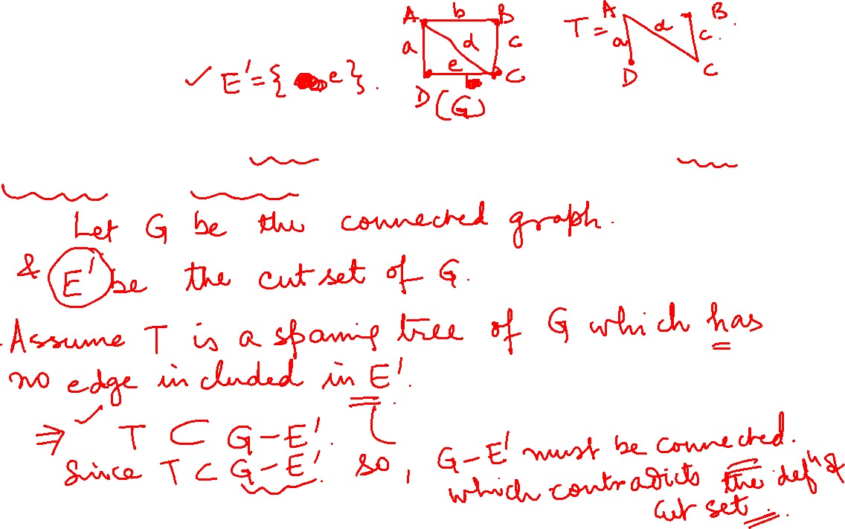
Graph Theory and its Applications Properties of Cut Sets
Theorem : Prove that every cut set in a connected graph G must contain atleast one branch of every spanning tree.
Proof:

Slide 16
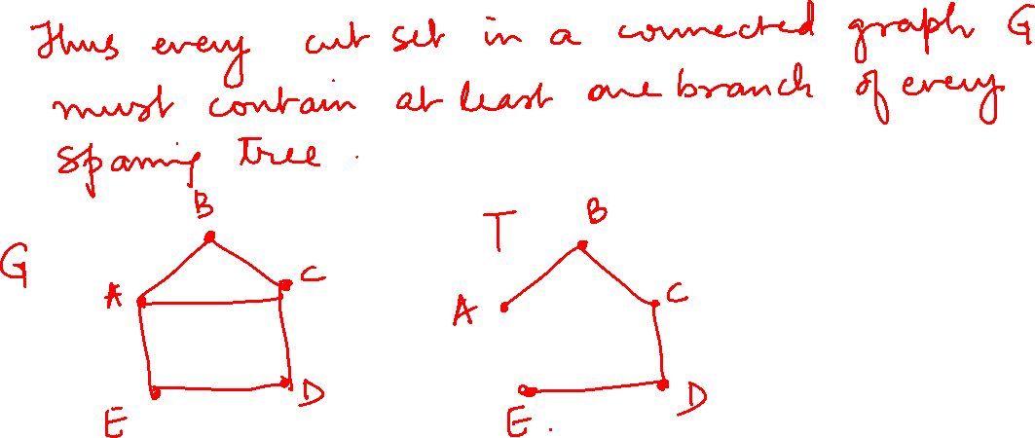

Slide 17























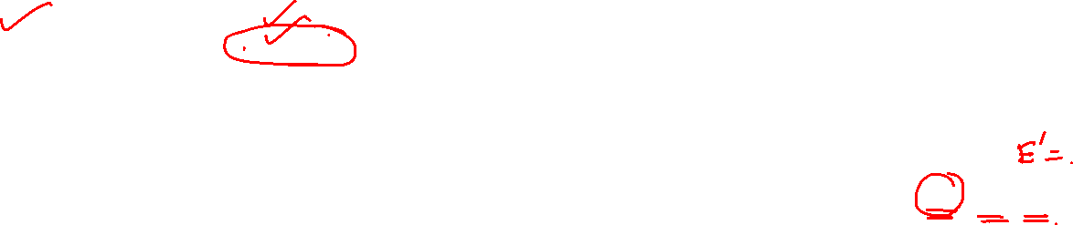
Graph Theory and its Applications Properties of Cut Sets
A
B
AB
AB, AD
AB, AD
AD
D
C
Cut Set
{AB, AC, AD}
K
4
AB, AC
AB
AD
AC
AB
AB,AC,
AD
G - Q
AC
AB, AC
AD, AC
AC
AD, AC
AD

Slide 18
Graph Theory and its Applications Properties of Cut Sets
Theorem : Prove that every cut set in a connected graph G must contain atleast one branch of every spanning tree.
Proof:
Let G be connected graph and S be a cut set of G
Assume T is a spanning tree of G which has no edge included in cut set S. Implies that T is completely contained in G-S
Hence G must be connected graph- contradicts the cut set definition.
Hence every cut set in a connected graph G must contain atleast one branch of every spanning tree.

Slide 19
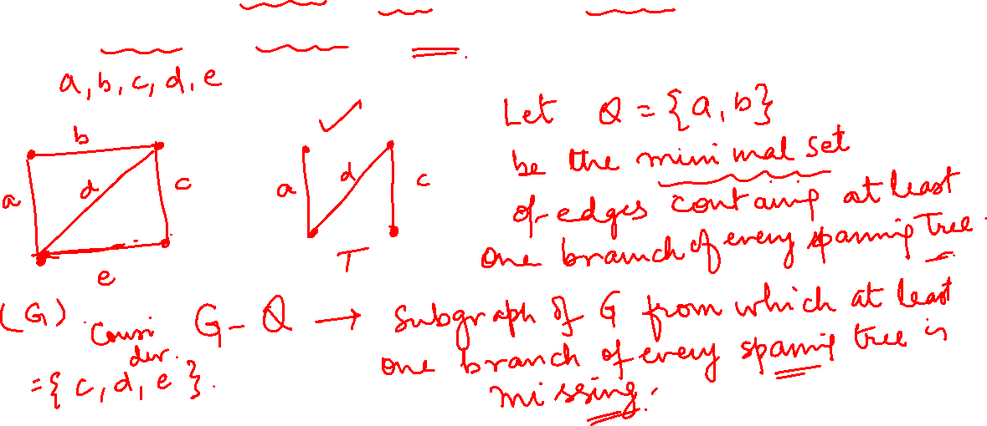
Graph Theory, Applications and Combinatorics Properties of Cut Sets
Theorem: Prove that in a connected graph G any minimal set of edges containing atleast one branch of every spanning tree is a cut set.
Proof:

Slide 20
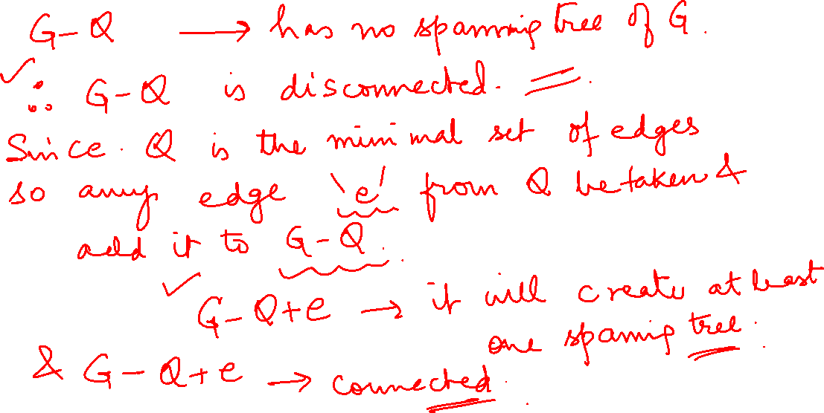

Slide 21
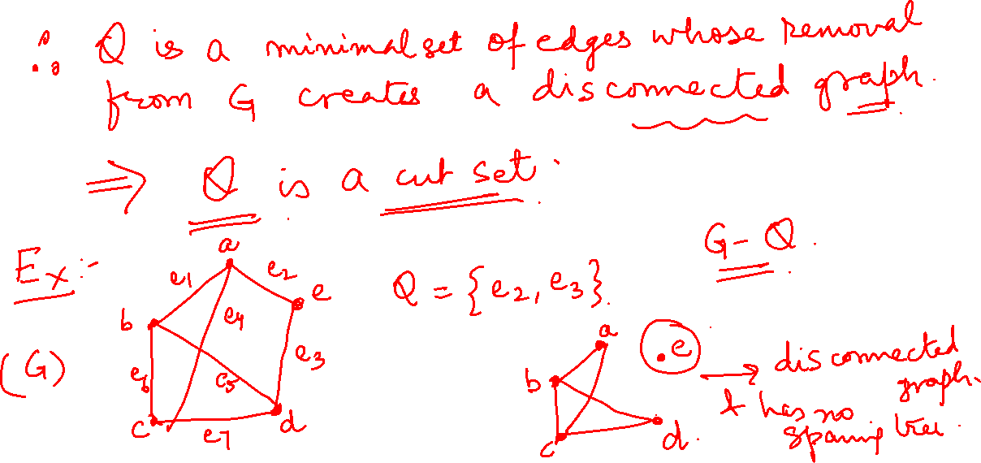

Slide 22
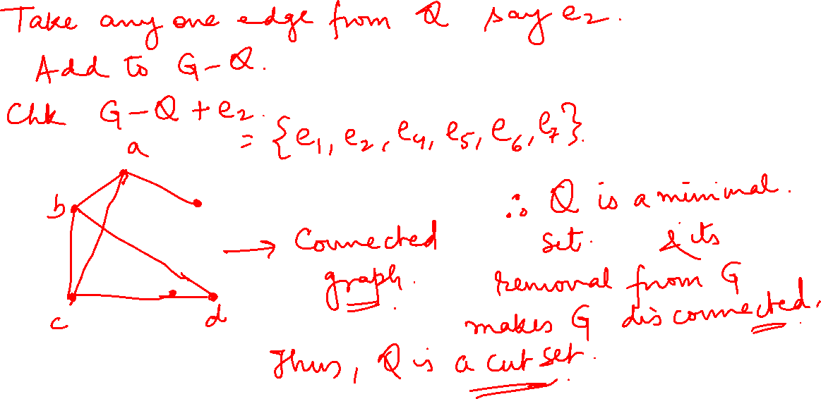

Slide 23
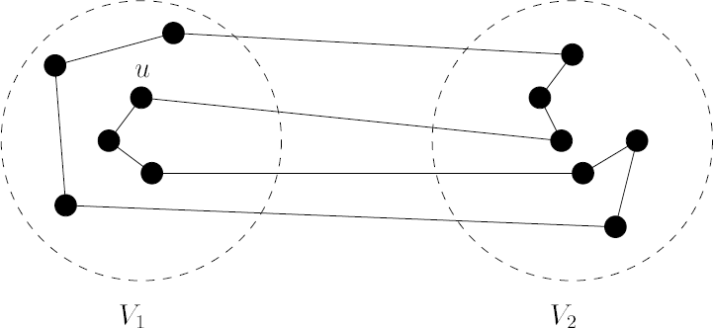
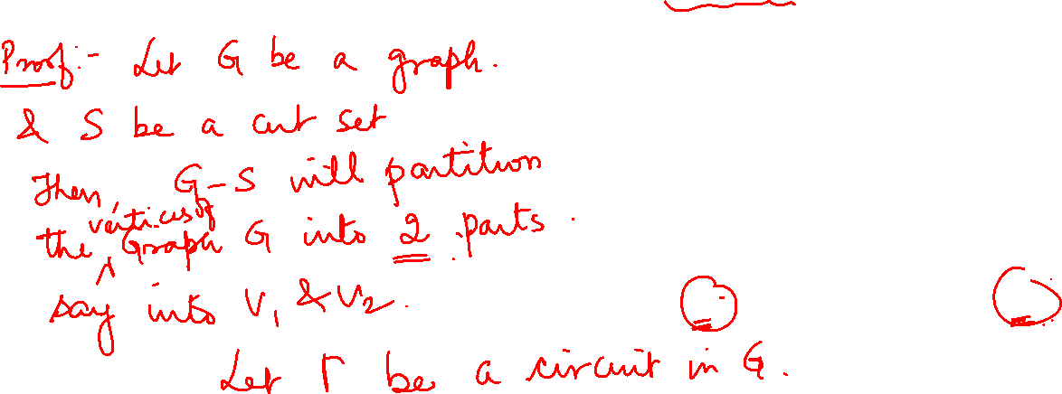
Graph Theory, Applications and Combinatorics Properties of Cut Sets
Theorem : Every circuit has an even number of edges in common with any cut set.

Slide 24
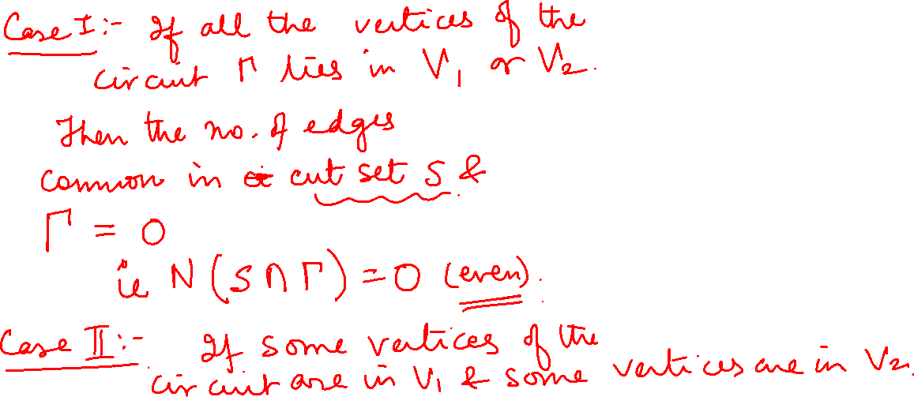
Graph Theory, Applications and Combinatorics Properties of Cut Sets

Slide 25
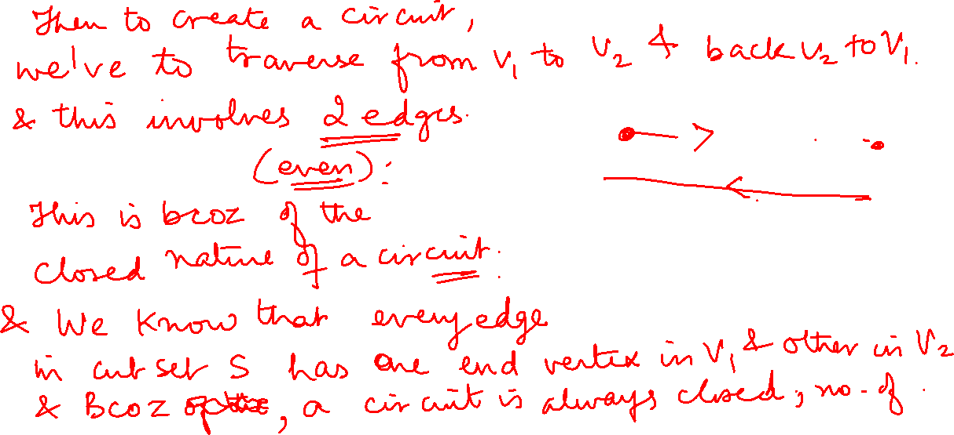
Graph Theory, Applications and Combinatorics Properties of Cut Sets

Slide 26
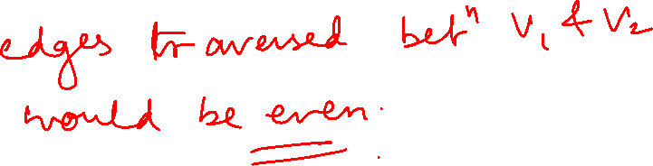
Graph Theory, Applications and Combinatorics Properties of Cut Sets

Slide 27
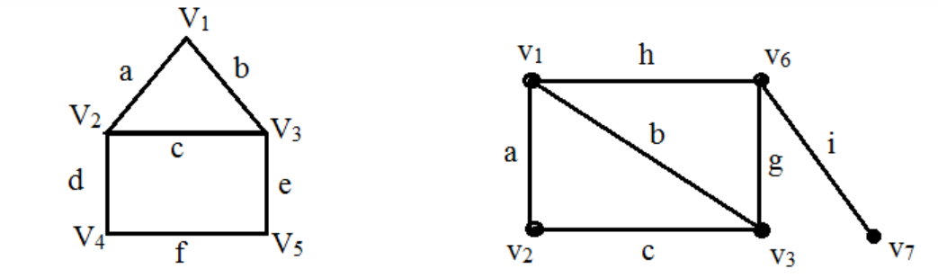
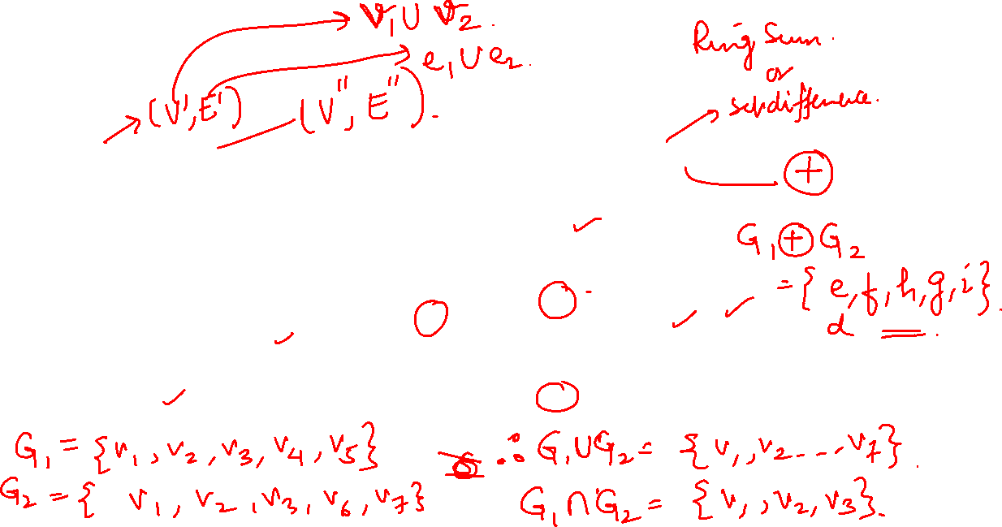
Graph Theory and its Applications
Some Graph Operations
Let G1 and G2 be 2 graphs. Find $G1 ∪G2, G1∩G2, G1∆G2$

Slide 28
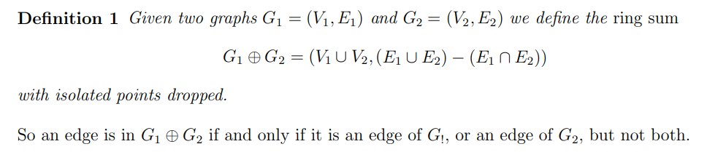
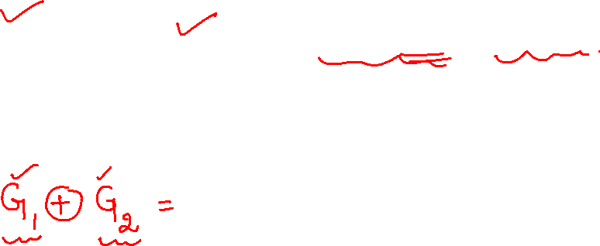
Graph Theory, Applications and Combinatorics All Cut Sets in a Graph

Slide 29
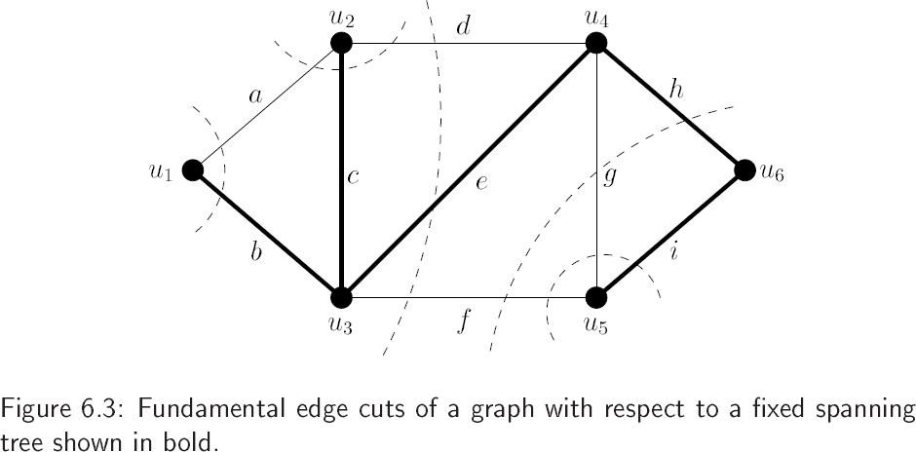
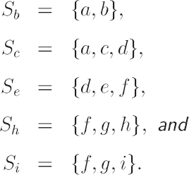
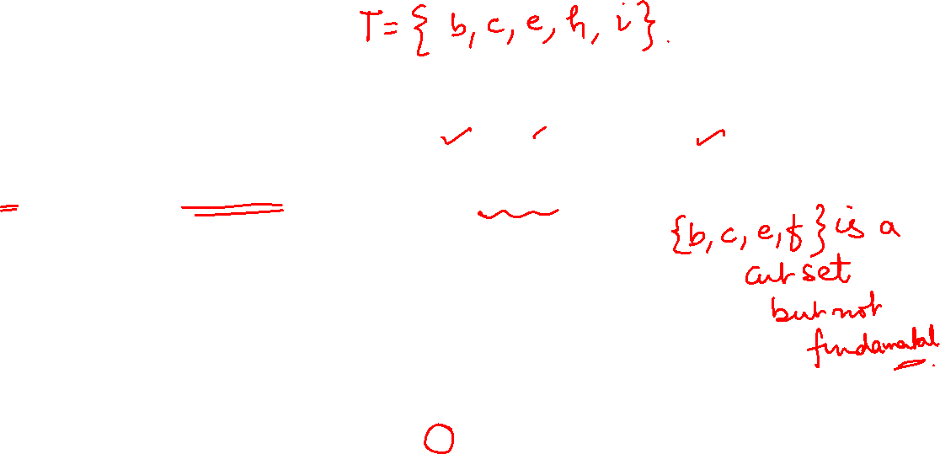
Graph Theory and its Applications
All Cut Sets in a Graph
Fundamental Cut Set with respect to a tree T
Consider a spanning tree T of a connected graph G. Let b be a branch in T. If cut set S will contain only one branch and one or more chords. It is called basic cut set or fundamental cut set.

Slide 30
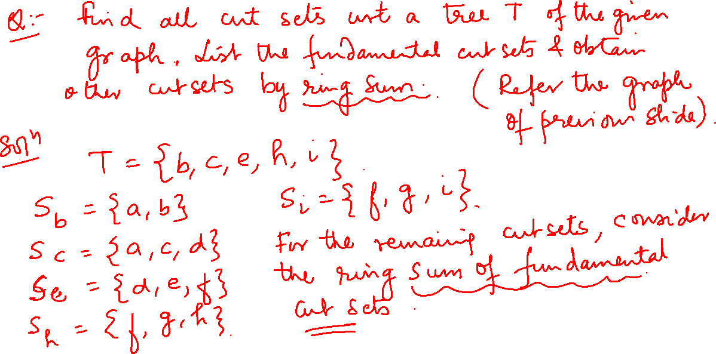

Slide 31
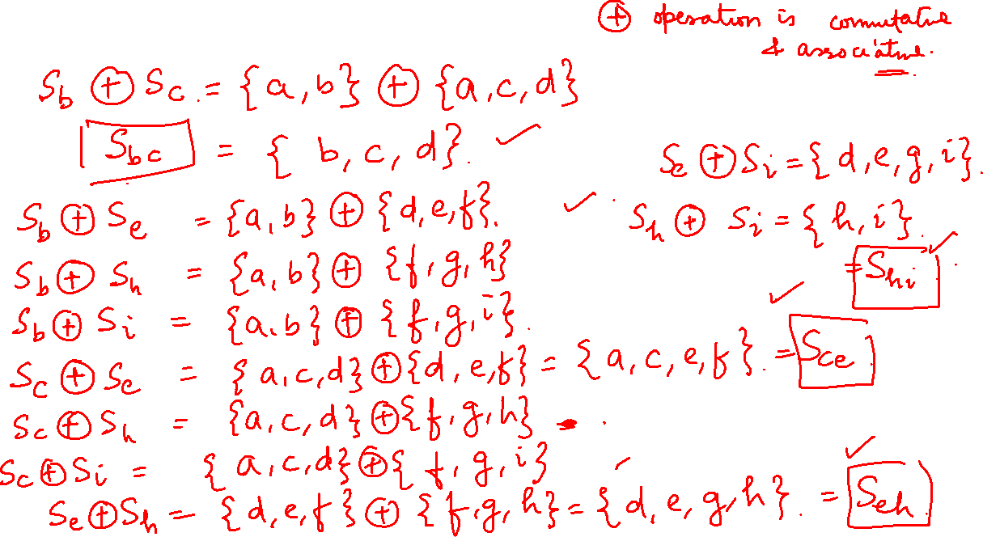

Slide 32
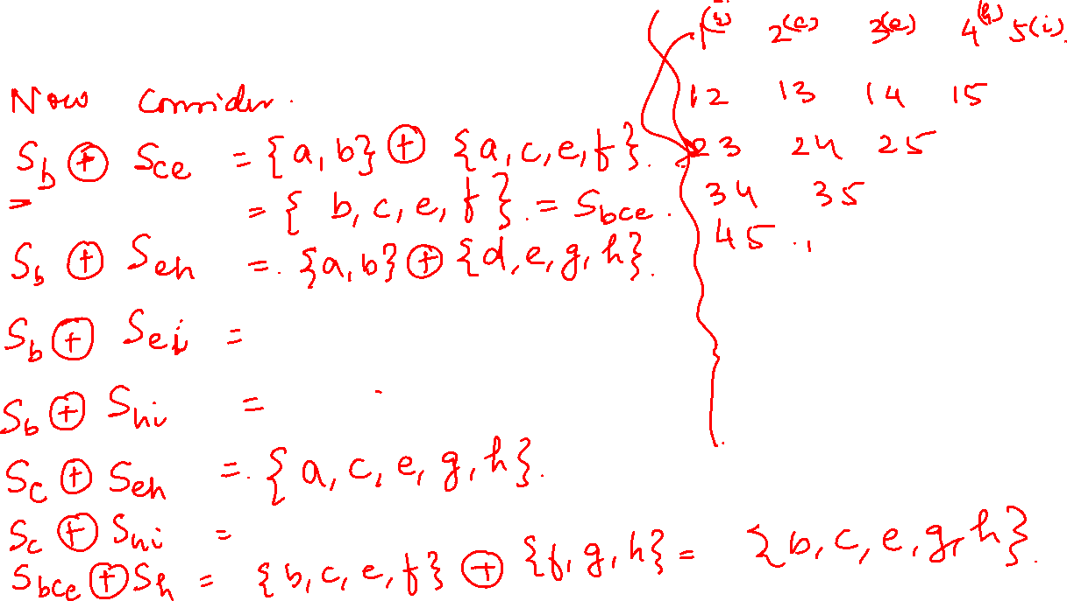

Slide 33
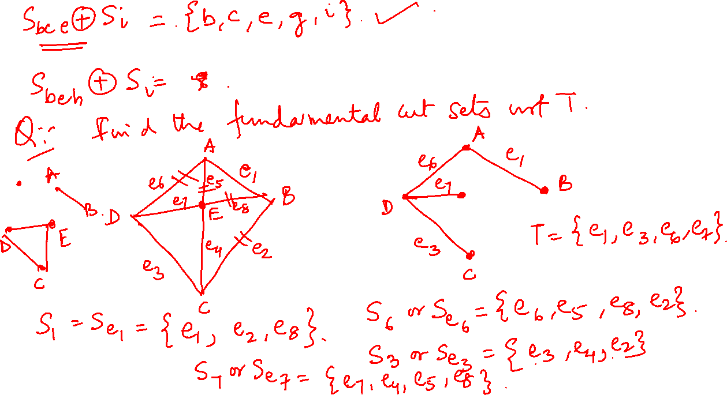

Slide 34
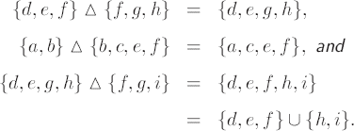
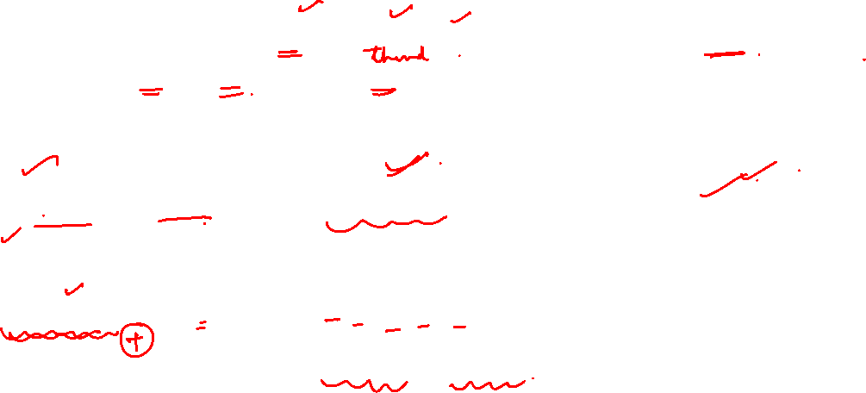
Graph Theory, Applications and Combinatorics All Cut Sets in a Graph
Theorem
Let G be a connected graph. Let S1 and S2 be two different cuts of G. Then the ring sum of S1 and S2 is either a new cut set or a disjoint union of cut sets.

Slide 35
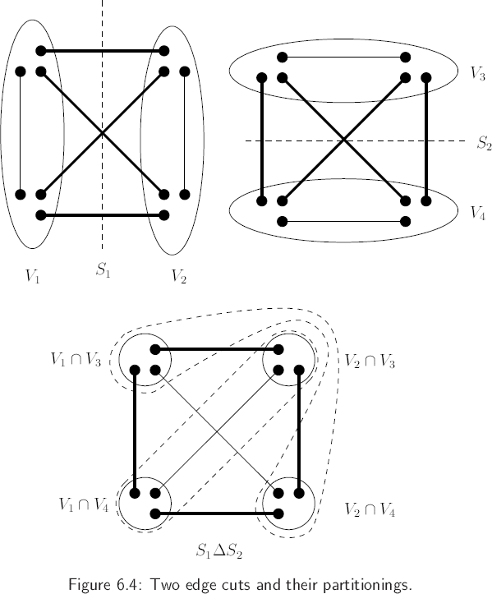
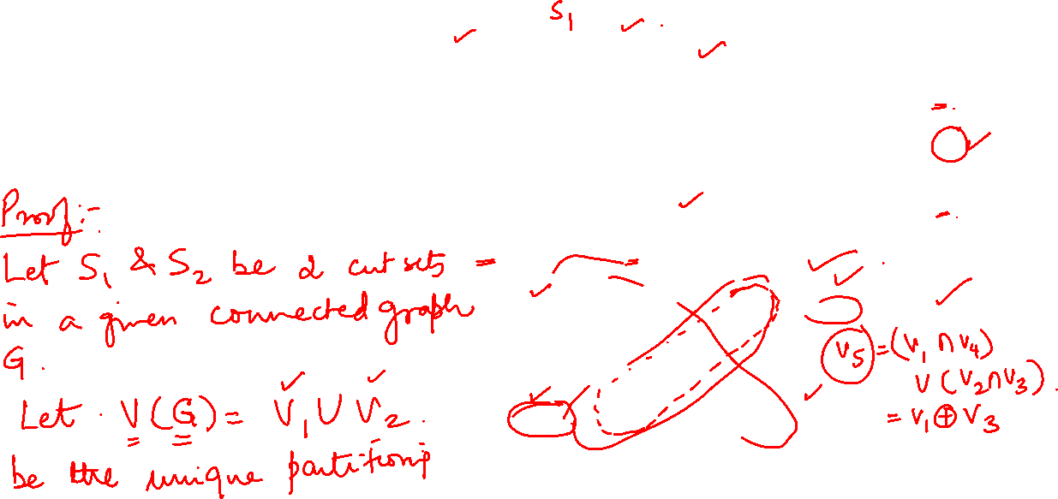
Graph Theory and its Applications
All Cut Sets in a Graph
Theorem
Let G be a connected graph. Let S1 and S2 be two different cuts of G. Then the ring sum of S1 and S2 is either a new cut set or a disjoint union of cut sets.

Slide 36
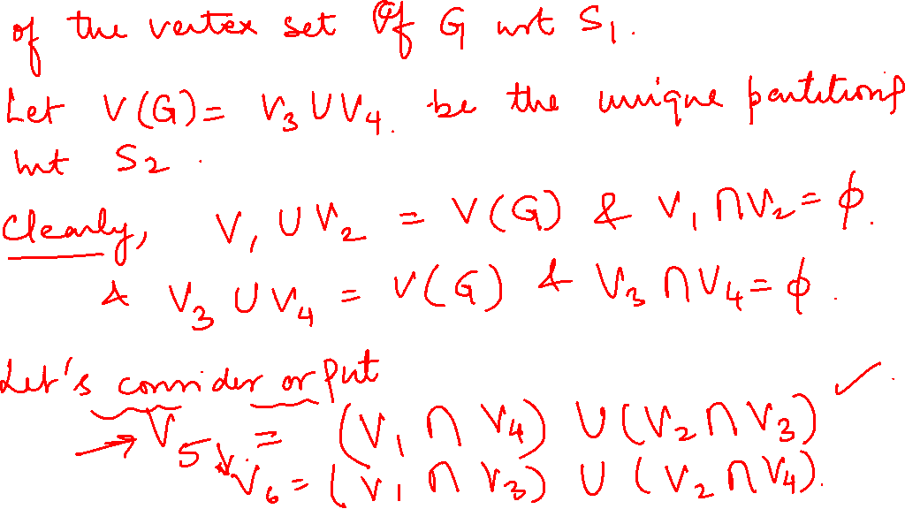

Slide 37
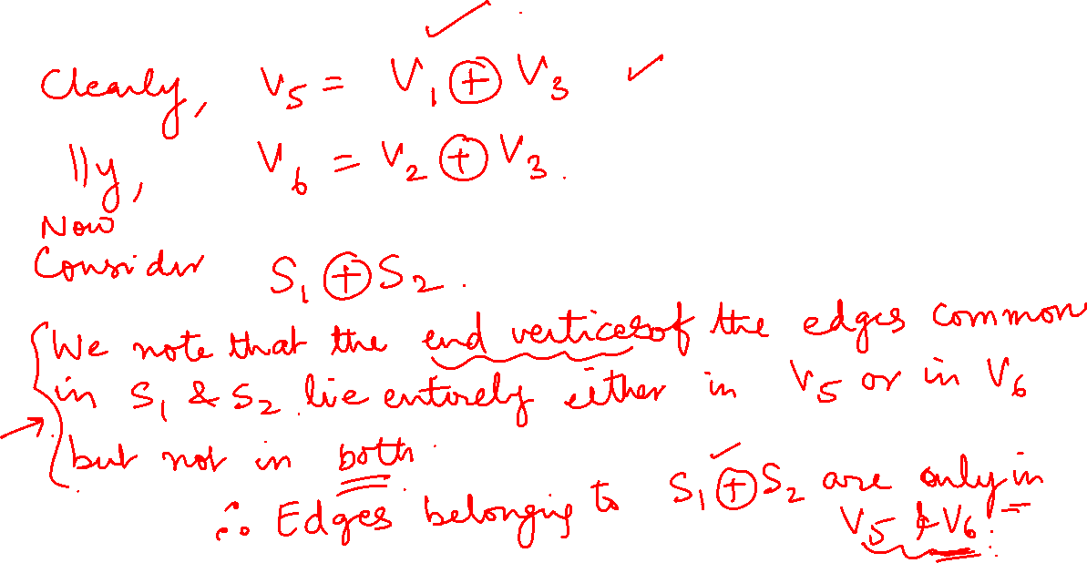

Slide 38
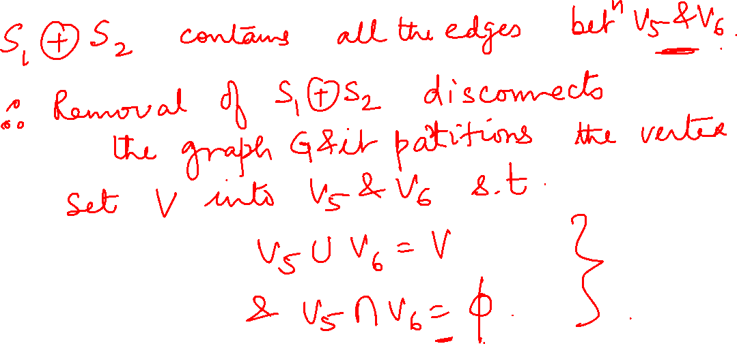

Slide 40
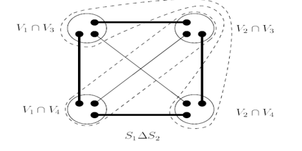
Graph Theory, Applications and Combinatorics All Cut Sets in a Graph
.

Slide 41
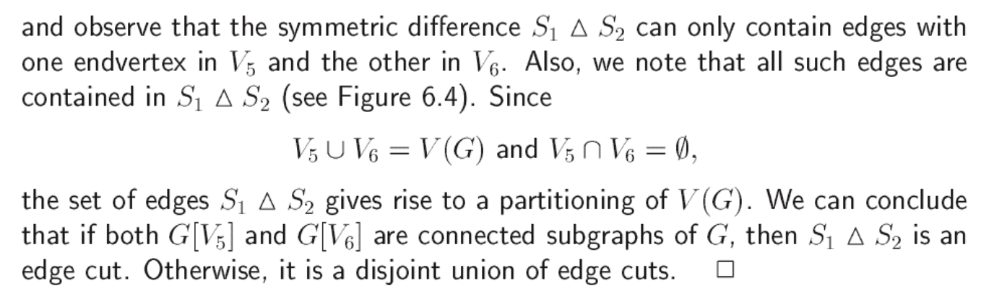
Graph Theory, Applications and Combinatorics All Cut Sets in a Graph
Theorem
Let G be a connected graph. Let S1 and S2 be two different cuts of G. Then the ring sum of S1 and S2 is either a new cut set or a disjoint union of cut sets.

Slide 42
Graph Theory, Applications and Combinatorics All Cut Sets in a Graph
Fundamental Cut Set with respect to a tree T
List the fundamental cut sets and obtain other cut sets by ring sum

Slide 43







Graph Theory, Applications and Combinatorics All Cut Sets in a Graph
Fundamental Cut Set with respect to a tree T
List the fundamental cut sets and obtain other cut sets by ring sum
A
A
B
B
D
E
D
E
C
C

Slide 44
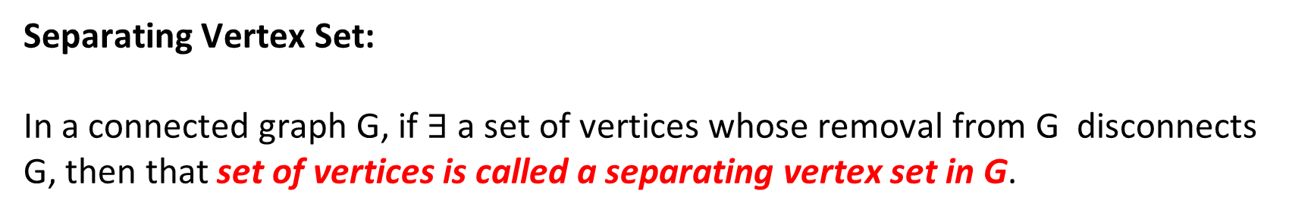
Graph Theory and its Applications Cut Sets
Separating Vertex Set:
In a connected graph G, if $∃$a set of vertices whose removal from G disconnects G, then that set of vertices is called a separating vertex set in G.
a
b
The Set { a, d } is a separating vertex set
b
e
d
c
c
e

Slide 45
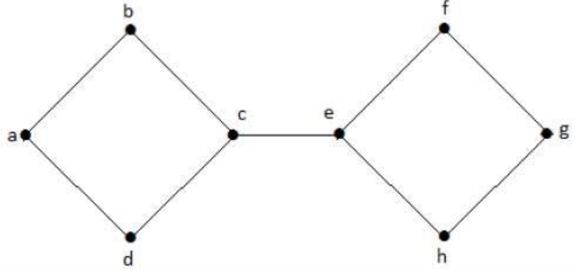
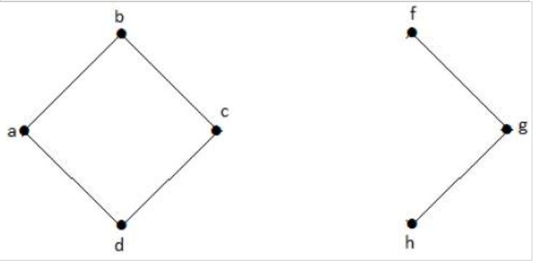
Graph Theory, Applications and Combinatorics Cut Sets
Cut Vertex:
If a separating vertex set in a connected graph has only one vertex then that vertex is called a cut-vertex in the graph
In this graph, [(c, e)] is called cut edge.
In the above graph, vertices 'e' and 'c' are the cut vertices.

Slide 46
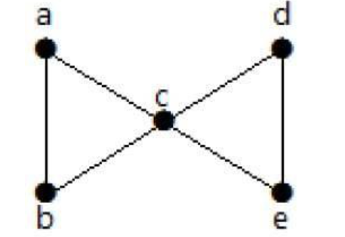
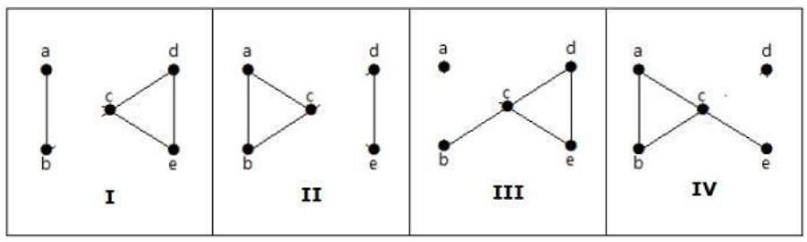
Graph Theory and its Applications
Edge Connectivity
Let ‘G’ be a connected graph.
The minimum number of edges whose removal makes ‘G’ disconnected is called edge connectivity of G.
Notation − λ(G)
OR the number of edges in a smallest cut set of G is called the edge connectivity of G.
If ‘G’ has a cut edge, then λ(G) is 1. (edge connectivity of G.)

Slide 47
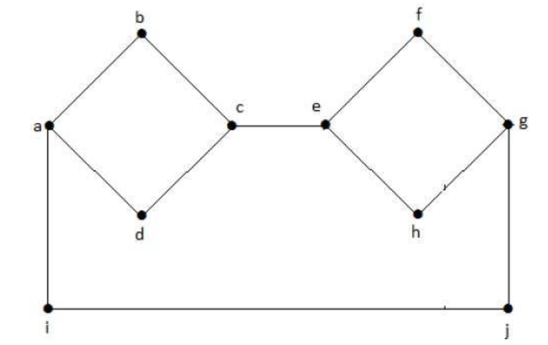

Graph Theory and its Applications
Vertex Connectivity
Let ‘G’ be a connected graph.
The minimum number of vertices whose removal makes ‘G’ either disconnected or reduces ‘G’ into a trivial graph is called its vertex connectivity.
Notation − K(G)
In this graph, removing the vertices ‘e’ and ‘i’ makes the graph disconnected.
If G has a cut vertex, then K(G) = 1.
For this graph, minimum no. of vertices to make it disconnected =2
$$∴K\left(G\right)=2$$

Slide 48



Graph Theory and its Applications
Vertex Connectivity
Find the cut vertices

Slide 49
Graph Theory, Applications and Combinatorics Cut Sets
For any connected graph G, its degree 𝛿(G), its edge connectivity and vertex connectivity satisfy the inequality
K(G) ≤ λ(G) ≤ 𝛿(G)
known as Whitney’s inequality

Slide 50

Graph Theory, Applications and Combinatorics Cut Sets
Edge connectivity λ(G) and Vertex connectivity K(G) of a tree with two or more vertices is always 1.
For any cycle C_{n} on 3 or more vertices K(G) = 2
For a complete graph K_{n}, K(K_{n})= n-1
For a complete Bipartite graph K_{m,n},
$K(Km,n) = min⁡\{m,n\}$

Slide 54
Graph Theory, Applications and Combinatorics
Cut Sets
Find the edge connectivity and vertex connectivity of the graphs Do they satisfy whitney’s inequality

Slide 55
Graph Theory, Applications and Combinatorics
Cut Sets

Slide 56
Graph Theory, Applications and Combinatorics
Cut Sets

Slide 57
Graph Theory, Applications and Combinatorics
Cut Sets

Slide 58
Graph Theory, Applications and Combinatorics
Cut Sets

Slide 59
Graph Theory, Applications and Combinatorics
Cut Sets

Slide 60
Graph Theory, Applications and Combinatorics Fundamental circuits and Cut Sets
Theorem
Let G be a connected graph and T a fixed spanning tree of G. For a chord c of G with respect to T, Let Γc be the fundamental circuit of G determined by c. For a branch b of G with respect to T, Let Sb be the fundamental cut set determined by b. Then c ∈ Sb if and only if b ∈ Γc
S
A
B
F
C
E
D

Slide 61
Graph Theory, Applications and Combinatorics Fundamental circuits and Cut Sets
Theorem
Let G be a connected graph and T a fixed spanning tree of G. For a chord c of G with respect to T, Let Γc be the fundamental circuit of G determined by c. For a branch b of G with respect to T, Let Sb be the fundamental cut set determined by b. Then c ∈ Sb if and only if b ∈ Γc
Proof:

Slide 62


Slide 63
Graph Theory, Applications and Combinatorics Fundamental circuits and Cut Sets
Theorem
Let G be a connected graph and T a fixed spanning tree of G. For a chord c of G with respect to T, Let Γc be the fundamental circuit of G determined by c. For a branch b of G with respect to T, Let Sb be the fundamental cut set determined by b. Then c ∈ Sb if and only if b ∈ Γc
Proof: on the other hand if b ∉ Γc then the vertices of Γc are all in V1 or all in V2. Hence edge c is not contained in Sb. This holds good for any chord c.
Hence the theorem.

Slide 64




Graph Theory, Applications and Combinatorics Network Flow

Slide 65
Graph Theory, Applications and Combinatorics Network Flow
Capacity
u
20
10
Source, Sink
s
30
t
Capacity Condition
10
20
Conservation Condition
v
Value of a flow

Slide 66
Graph Theory, Applications and Combinatorics Network Flow
Max Flow Min Cut Theorem
Maximum possible flow between two vertices A and B in a transport network is equal to the minimum of the capacities of all cut sets with respect to A and B
Consider any cut set S with respect to the vertices A and B
In G – S there occurs no path between A and B
Therefore every path in G between A and B must contain atleast one edge
from S
Accordingly every flow between A and B must pass through atleast one edge that belong to S
Hence total flow rate between A and B cannot exceed the capacity of S.

Slide 67
Graph Theory, Applications and Combinatorics Network Flow
6
B
A
8
3
5
Z
2
7
D
4
C

Slide 68
6
B
B
A
A
8
8
3
5
Z
Z
2
2
7
7
D
4
C
D
4
C

Slide 70
Graph Theory, Applications and Combinatorics Network Flow
B
5
C
2
7
2
Z
4
A
6
9
E
3
D

Slide 71
THANK YOU
Dr. Arti Arya
Department of Computer Science &Engineering
artiarya@pes.edu

